Slide 1
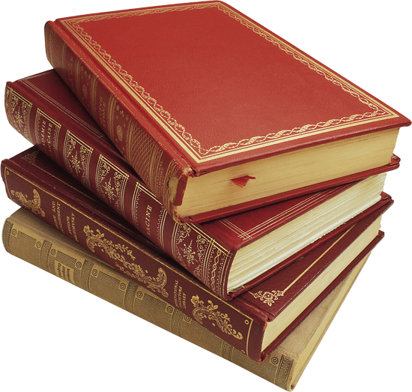
Literary quiz
Prepared by Smirnova I.A.

Slide 2
1. Compose the titles of books written by the British writers
1 | The Pickwick... |  | a. ...bondage
2 | Dark... |  | b. ...Crusoe
3 | Of human... |  | c. ...Lear
4 | Alice... |  | d. ...Juliet
5 | Jane... |  | e. ...Materials
6 | Robinson... |  | f. ...Papers
7 | Oliver... |  | g. ...Eyre
8 | King... |  | h. ...Pan
9 | Romeo and... |  | i. ...Twist
10 | Peter... |  | j. ... in Wonderland

Slide 3
1 | The Pickwick... |  | f. Papers
2 | Dark... |  | e. Materials
3 | Of human... |  | a. bondage
4 | Alice... |  | j. in Wonderland
5 | Jane... |  | g. Eyre
6 | Robinson... |  | b. Crusoe
7 | Oliver... |  | i. Twist
8 | King... |  | c. Lear
9 | Romeo and... |  | d. Juliet
10 | Peter... |  | h. Pan

Slide 4
2. Match the titles of well-known books with the writers
1 | Walter Scott | A | Pride and Prejudice
2 | Roald Dahl | B | Harry Potter
3 | John Tolkien | C | Treasure Island
4 | Joanne Rowling | D | Ivanhoe
5 | R.L. Stevenson | E | The Gatekeepers
6 | Jane Austen | F | Charlie and Chocolate Factory
7 | Conan Doyle | G | Sherlock Holmes
8 | A. Horowitz | H | The Lord of the Rings

Slide 5
1 | Walter Scott | D | Ivanhoe
2 | Roald Dahl | F | Charlie and Chocolate Factory
3 | John Tolkien | H | The Lord of the Rings
4 | Joanne Rowling | B | Harry Potter
5 | R.L. Stevenson | C | Treasure Island
6 | Jane Austen | A | Pride and Prejudice
7 | Conan Doyle | G | Sherlock Holmes
8 | A. Horowitz | E | The Gatekeepers

Slide 6
3. Determine genre
1 | Criminals, robbers, killers. There is always a clever detective or a policeman who catches them in the end. | a) romance
2 | Aliens, spaceships, trips to the moon and star wars. | b) detective story
3 | The author describes somebody's life or writes about himself (herself). | c) adventure story
4 | Wizards, witches and other magic objects and words. Some wizards are bad, some witches are good. | d) science fiction
5 | Pirates, cowboys, boys and girls are always doing exciting things. You also find ships, faraway islands, lost treasure, and a lot of danger in these stories, but there is usually a happy ending. | e) horror
6 | Vampires, witches, ghosts and scary supernatural events. | f) biography
7 | Things that happened in the past. Some characters may not be real, but the description of the period is usually very good. | g) fantasy
8 | Love and hate. The characters go through a lot of difficulties to come together. | i) history book

Slide 7
1 | Criminals, robbers, killers. There is always a clever detective or a policeman who catches them in the end. | b) detective story
2 | Aliens, spaceships, trips to the moon and star wars. | d) science fiction
3 | The author describes somebody's life or writes about himself (herself). | f) biography
4 | Wizards, witches and other magic objects and words. Some wizards are bad, some witches are good. | g) fantasy
5 | Pirates, cowboys, boys and girls are always doing exciting things. You also find ships, faraway islands, lost treasure, and a lot of danger in these stories, but there is usually a happy ending. | c) adventure story
6 | Vampires, witches, ghosts and scary supernatural events. | e) horror
7 | Things that happened in the past. Some characters may not be real, but the description of the period is usually very good. | i) history book
8 | Love and hate. The characters go through a lot of difficulties to come together. | a) romance

Slide 8
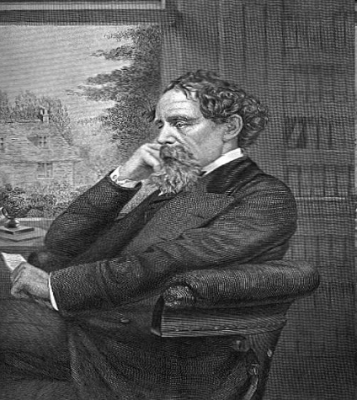
4. Who is it?
Charles Dickens

Slide 9
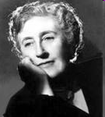
Agatha Christie

Slide 10
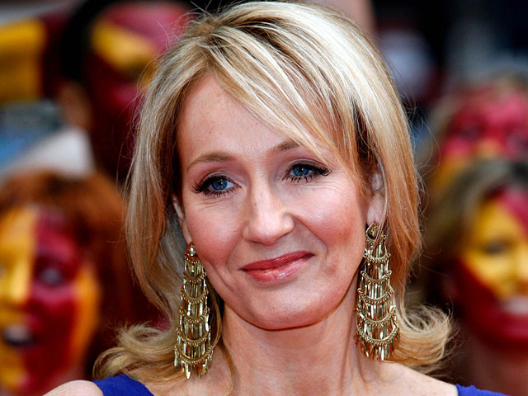
Joanne Rowling

Slide 11
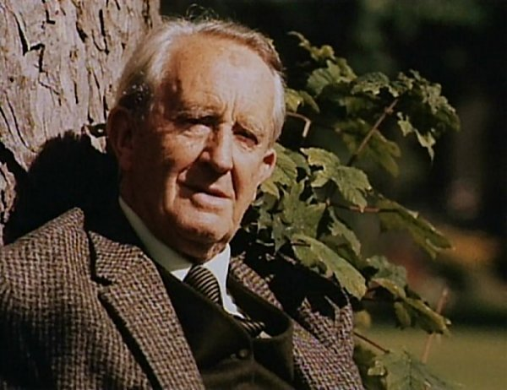
John Tolkien

Slide 12
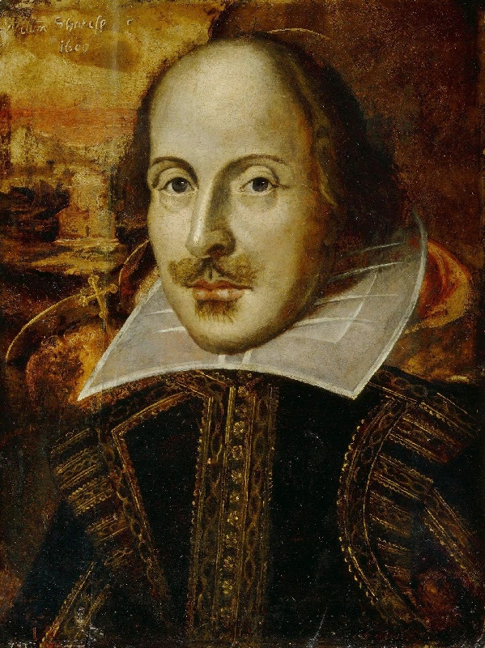
William Shakespeare

Slide 13
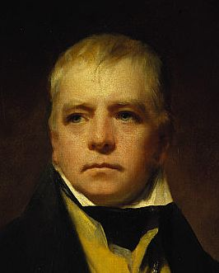
Walter
Scott

Slide 14
5. Right or wrong
"Romeo and Juliet" is a comedy.
Charles Dickens is the author of "Oliver Twist".
There are no famous writers in Britain.
Charlotte Brontee wrote "Jane Eyre".
Shakespeare performed his plays in the Globe theatre.
Dictionaries are books about hobbies, crafts, plants, animals and weather.
Fairy-tale is a book that tells an exciting story of crime and violence.
Smoking, eating and dancing are allowed in the library.
"Alice in Wonderland" was written by Lewis Carroll.
“Murder on the Orient Express” is a detective story written by Agatha Christie.

Slide 15
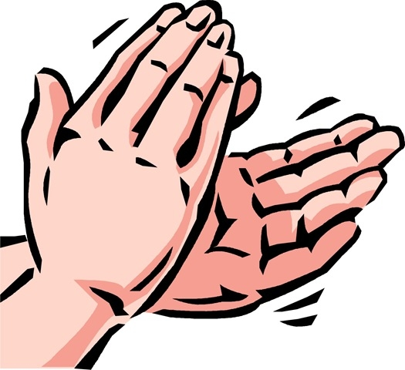
Congratulations to the winners

Slide 16
Thank you for your participation!

